Slide 1
TNE20002/TNE70003
Topic 5 OSPF V1.0

Slide 2
OSPF
An implementation of a Link-State Routing Protocol
OSPFv1 -1987 OSPFv2 – 1991,1998 OSPFv3 for IPV6 - 1999
Algorithm: Shortest-Path-First to select least cost path
Data Structures:
Adjacency Database
Link State Database
Forwarding Database
Supports
Authentication and encryption
VLSM
Single Area
Multiple Areas

Slide 3
Link State Routing
Like a road map (Melways) creates
a topological map of the network area
and each router uses this map
to determine the least cost path
to any destination within network area

Slide 4
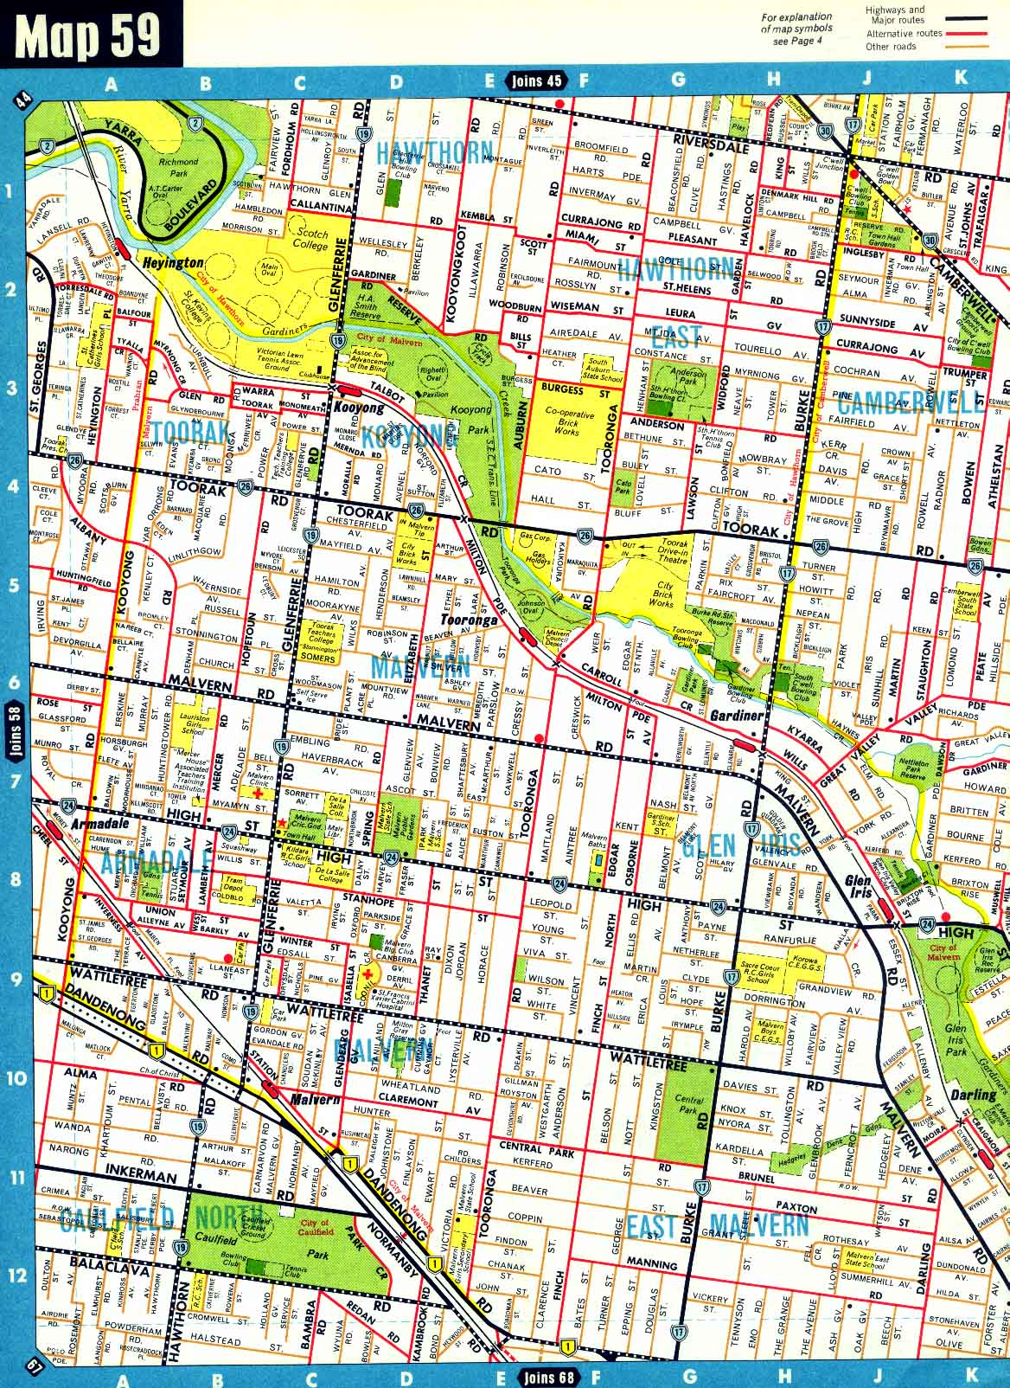
Topological Map (Network Area 59)

Slide 5
Link State Routing
The ultimate objective is that every router receives all the link state information about all other routers in the network area.
With this link state information, each router can create its own topological map of the network area and independently calculate the least cost path to every destination within network area.

Slide 6
Link-State Routing Convergence
1) Each router learns about its own directly connected networks
Routers exchange hello packets to meet other directly connected routers, their neighbors, form adjacency
2) Each router builds its own Link State Packet (LSP) which includes information such as
Neighbor ID
Link types
Bandwidths
3) LSP is flooded to all neighbors who in turn store and forward information to their neighbors
4) Once all routers have received all LSPs, router constructs a topological map (LSDB) of the network area
5) Each router executes SPF algorithm to create an SPF Tree
6) Each router is the root of its own SPF Tree
7) Each router uses SPF Tree to determine the least cost path to each destination, the least cost paths are put in the Routing Table

Slide 7
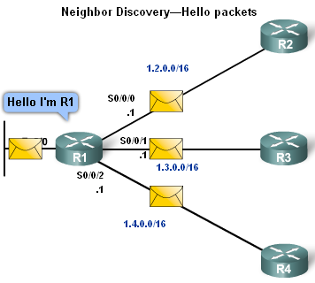
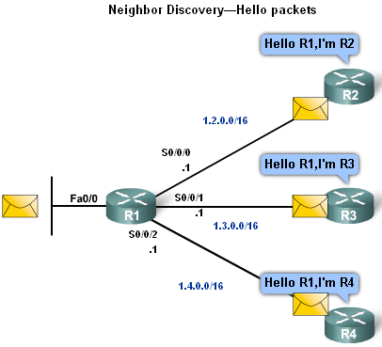
1) Link-State Routing: Discovering the Neighbors
Routers send Hello packets on connected interfaces
When a router learns it has a neighbor
Neighbors exchange Hello packets
They form an adjacency
Hello packets also serve as a “keep alive function”

Slide 8
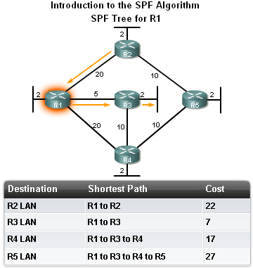
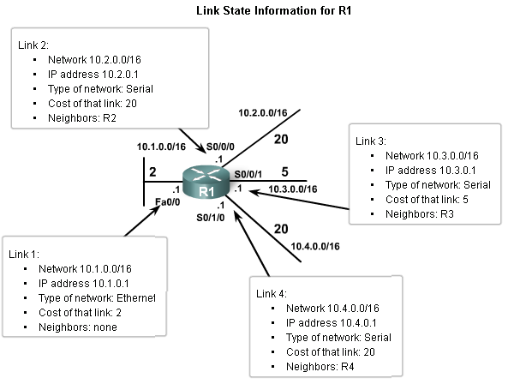
2A) Link-State Routing: R1 Link State Information

Slide 9
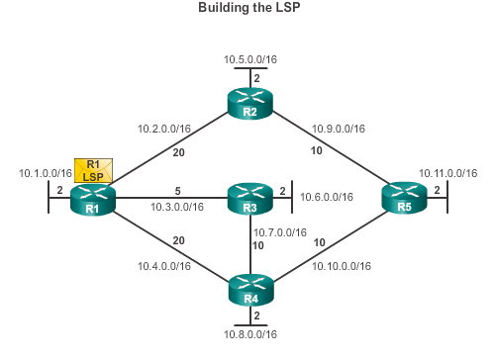
2B) Link-State Routing: R1 builds an LSP
Each router builds a link-state packet (LSP) containing the state of each directly connected link.
R1’s LSP Contains:
R1-> Ethernet network: 10.1.0.0/16; Cost 2
R1 -> R2: Serial point-to-point network; 10.2.0.0/16; Cost 20
R1 -> R3: Serial point-to-point network; 10.3.0.0/16; Cost 5
R1 -> R4: Serial point-to-point network; 10.4.0.0/16; Cost 20
Notes:
3.4.2.4 Building the Link-State Packet

Slide 10
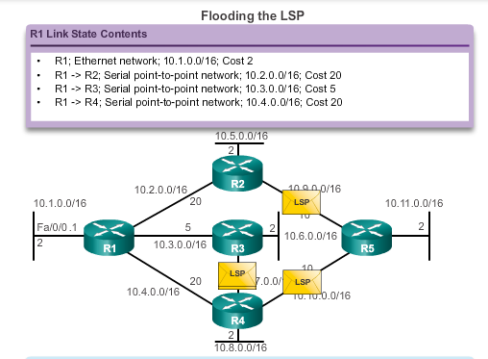
3) Link-State Routing: Flooding the LSPs
Each router floods the LSP to all neighbors, who then store all LSPs received in a link state database.
Notes:
3.4.2.5 Flooding the LSP

Slide 11
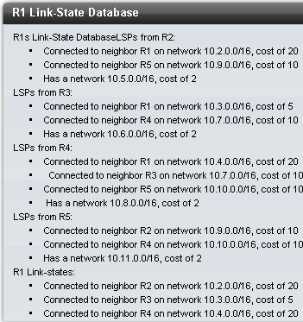
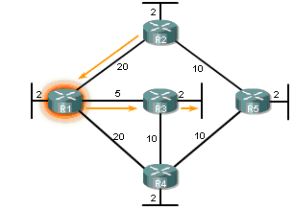
4) Build Link State Database: Cost R1 to R2 LAN, R1 to R3 LAN
R2 LAN
R3 LAN

Slide 12
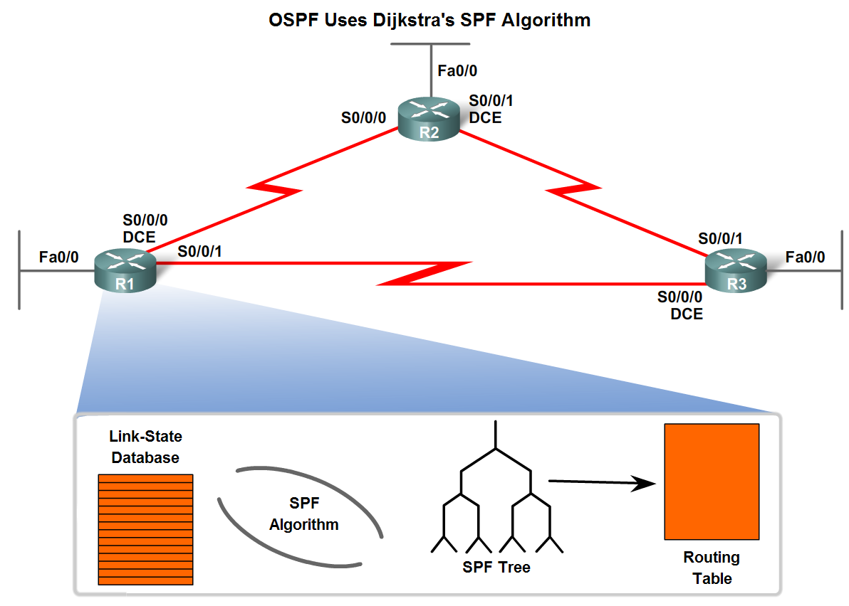
5,6) Link State Routing: SPF (Shortest Path First) Algorithm
This information is utilized on execution of Dijkstra SPF algorithm to create a SPF tree
SPF tree used to populate the routing table. Only the least cost (best) routes are put in the routing table

Slide 13
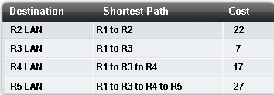
7) The least cost paths are put in the Routing Table
R1 Routing Table

Slide 14
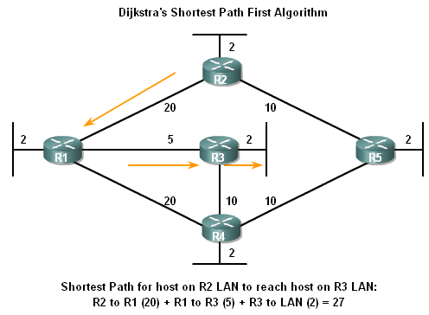
Link-State Routing: Cost R2 LAN to R3 LAN
R2 LAN
Cost
R3 LAN

Slide 15
OSPF Databases
Adjacency Database
List of all neighbor routers
Unique for each router
show ip ospf neighbor
Link State Database
List of information about all other routers in network area
The database shows the network topology
All routers within an network area have identical LSDBs
show ip ospf database
Forwarding Database (Routing Table)
List of least cost routes to other destinations within network area
Unique for each router
show ip route

Slide 16
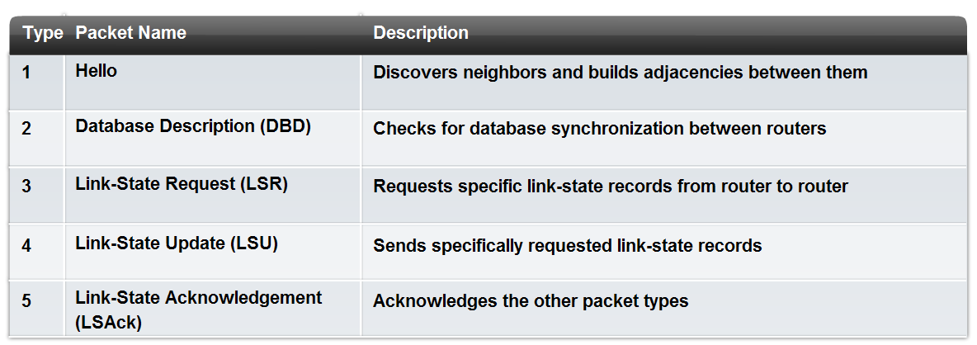
OSPF Packet Types

Slide 17
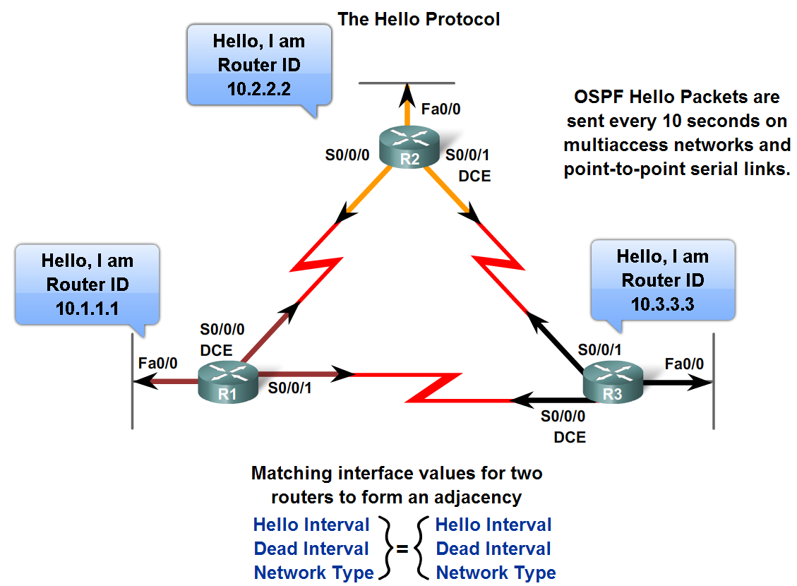
OSPF – Hello Protocol
Router ID of transmitting router
Router ID identifies router so link states can be organized
How does OSPF select an ID?
OSPF Hello Interval
Multicast (224.0.0.5)
10 secs
OSPF Dead Interval
The time that must transpire before the neighbor is considered down
Default is 4 times the hello interval

Slide 18
Configuring OSPF
To enable OSPF on a router use the router ospf process-id command.
Process id
between 1 and 65535
OSPF Routers
R1(config)# router ospf 1
R2(config)# router ospf 1
R3(config)# router ospf 1

Slide 19
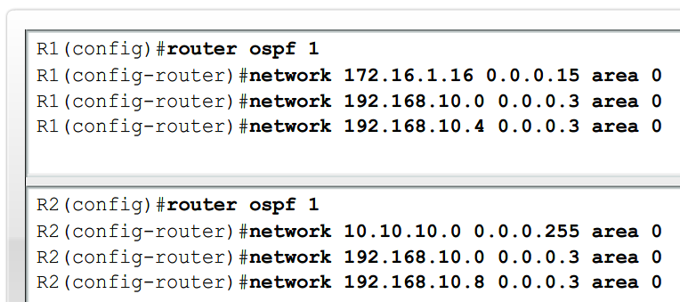
Configuring OSPF
OSPF network command
Requires entering: network address
wildcard mask - the inverse of the subnet mask
area-id - area-id refers to the OSPF area.
OSPF area is a group of routers that share link state information

Slide 20
OSPF – Determining Router Identification
To use OSPF a Router must have a Router ID to identify the router within the OSPF network area; it uses an IP address as its ID
Routers have multiple IP addresses, which one should be used?
Router ID is derived based on 3 criteria in order of precedence:
Configured using OSPF router-id command
If router-id command not used, router chooses highest IP address of any loopback interfaces.
If no loopback interfaces are configured, the highest IP address on any active interface is used

Slide 21
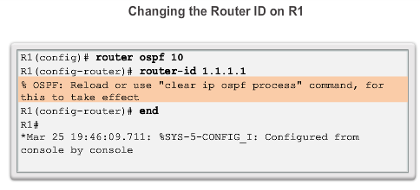
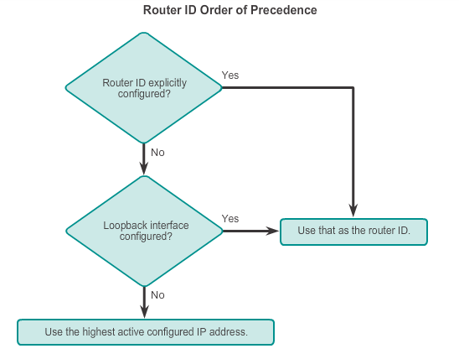
OSPF Router ID Explicitly Configured
Notes:
6.2.1.3 Router IDs
6.2.1.4 Configuring an OSPF Router ID
6.2.1.5 Modifying a Router ID
6.2.1.6 Using a Loopback Interface as the Router ID

Slide 22
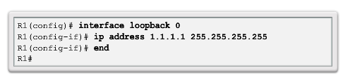
OSPF Router ID is Loopback Address
Notes:
6.2.1.3 Router IDs
6.2.1.4 Configuring an OSPF Router ID
6.2.1.5 Modifying a Router ID
6.2.1.6 Using a Loopback Interface as the Router ID

Slide 23
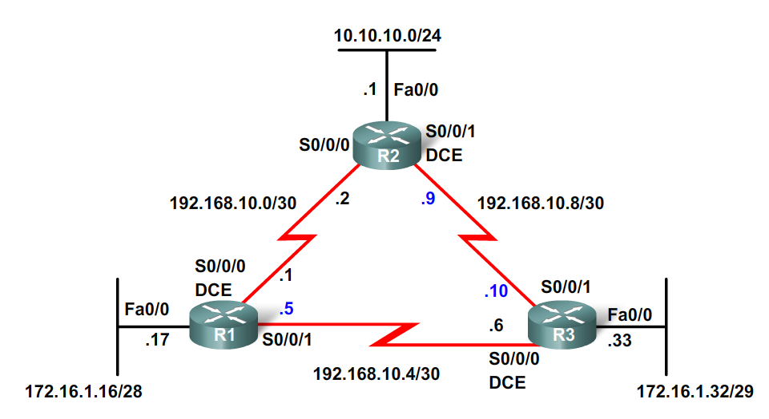
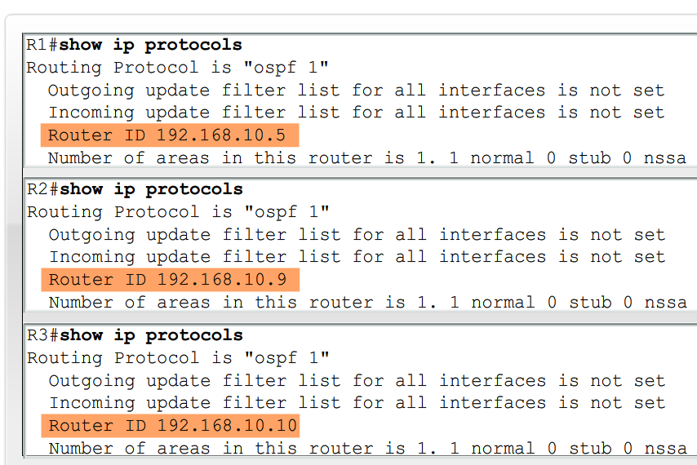
OSPF – Identification highest Active
Do the Router IDs chosen satisfy the criteria ?
To inspect Router ID use
show ip protocols
show ip ospf
show ip ospf interface

Slide 24
OSPF – Router Identification
Highest Active Interface
Default option
Has problems – eg when interface goes down, OSPF process crashes
Loopback Address
Loopback interface cannot fail, this improves OSPF stability
Router ID
ID always the same (like loopback)
Not a reachable address

Slide 25
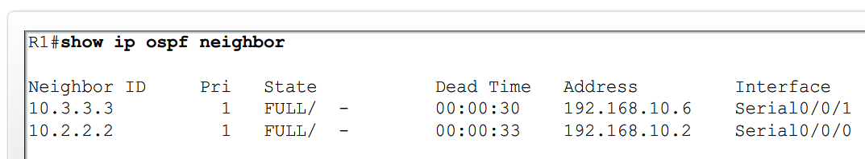
OSPF – Adjacency Verification
Use the show ip ospf neighbor command, displays Neighbor Adjacency:
No adjacency indicated by:
Neighboring router’s Router ID is not displayed
A state of full is not displayed
The Consequence of no adjacency:
No link state information exchanged
Inaccurate SPF trees and routing tables

Slide 26
OSPF – Verification
Command | Description
show ip protocols | Displays OSPF process ID, router ID, networks router is advertising & administrative distance
show ip ospf | Displays OSPF process ID, router ID, OSPF area information & the last time SPF algorithm calculated
show ip ospf interface | Displays hello interval and dead interval

Slide 27
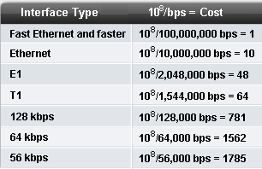
OSPF Cost
Cost is calculated using metric, bandwidth, of an interface
Cost is calculated using the formula 10⁸ / bandwidth
Reference bandwidth

Slide 28
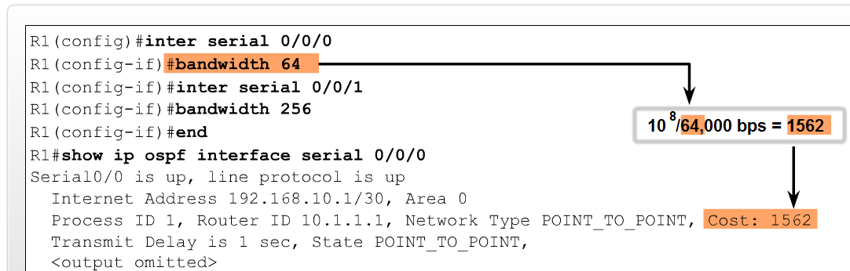
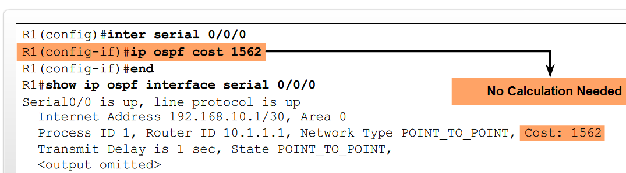
OSPF – Modifying the Cost
Both sides of a serial link should be configured with the same bandwidth
Two commands used to modify bandwidth value:
bandwidth – link cost must be calculated
ip ospf cost – allows you to directly specify interface cost
Calculation

Slide 29
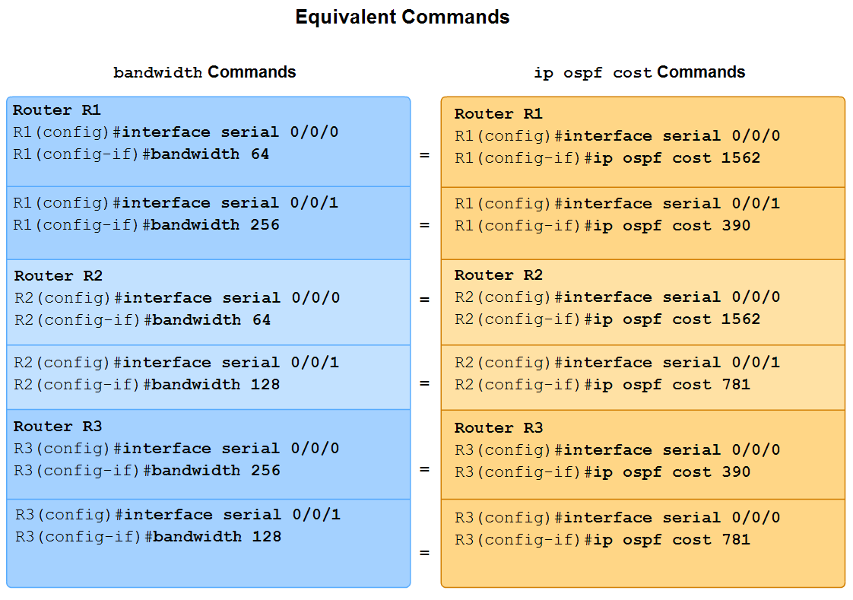
OSPF – Modifying the Cost
bandwidth and ip ospf cost command

Slide 30
OSPF Explained | Step by Step - YouTube
The END

